Slide 1
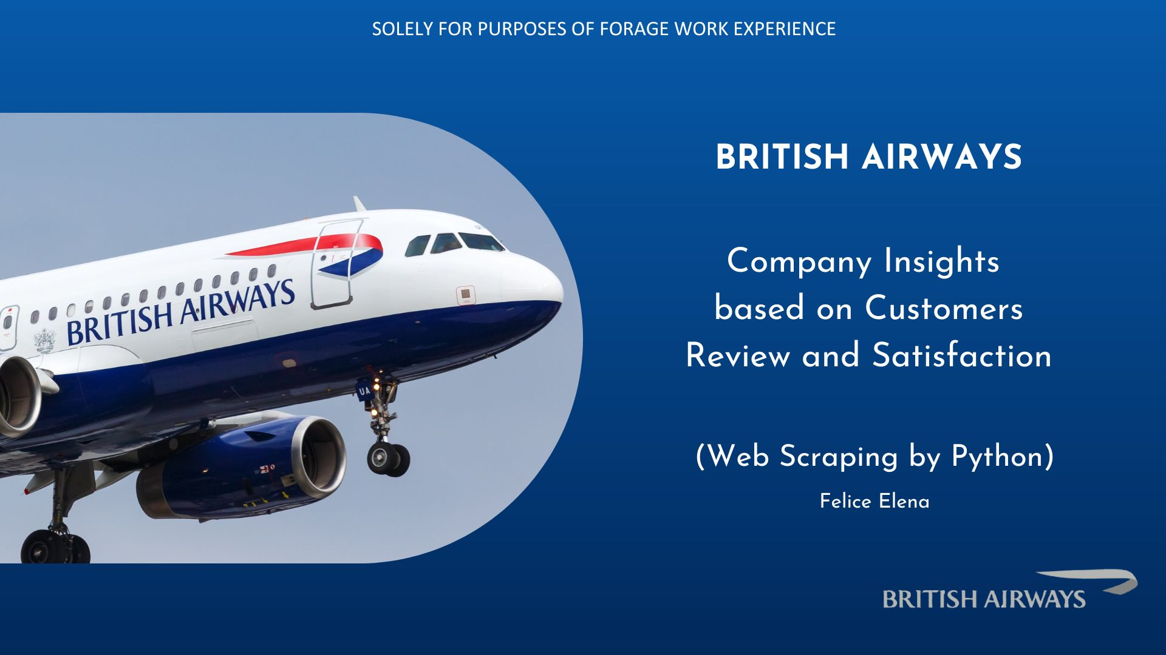
TITLE

Slide 2

Data of 1909 Customers Reviews from 2016 - 2023
Insights:
More than 50% of the customers (973) left positive reviews.
In Economy Class, 45% customers feels satisfied and 43% customers feels unsatisfied.
Around 33% customers in Business Class feels disappointed.
There are 38% customers in Premium Economy left negative reviews.

